Slide 1
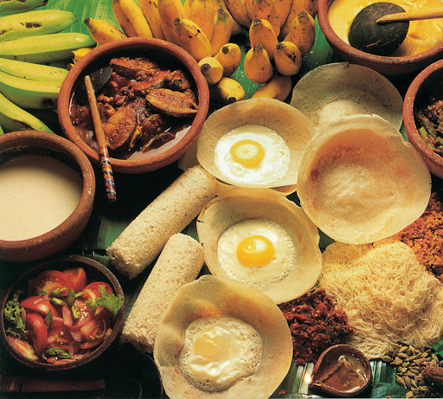
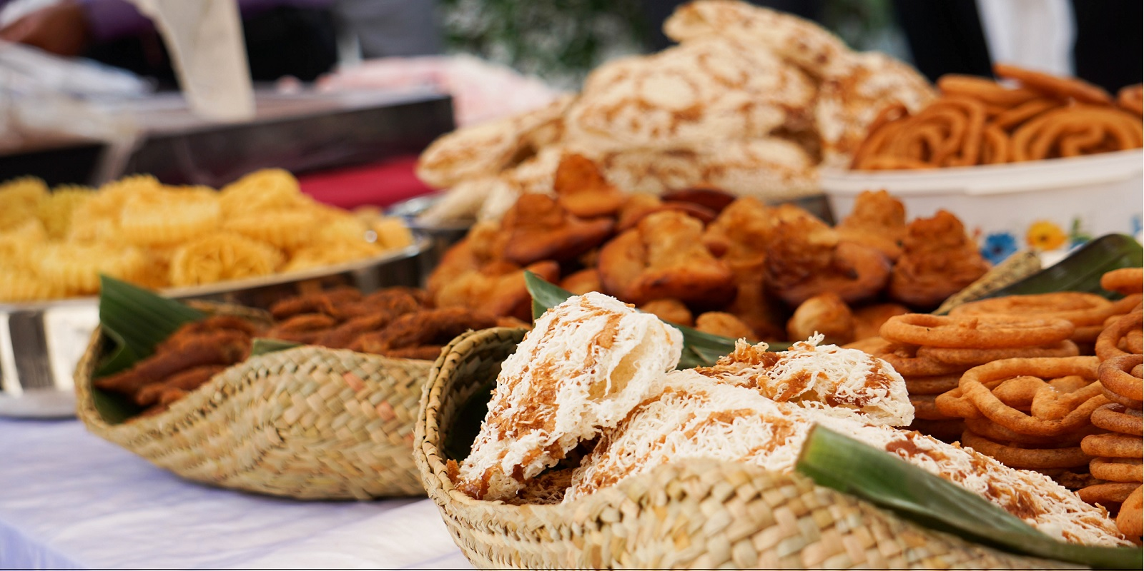
Traditional Food Ordering System
Final Project Presentation

Slide 2
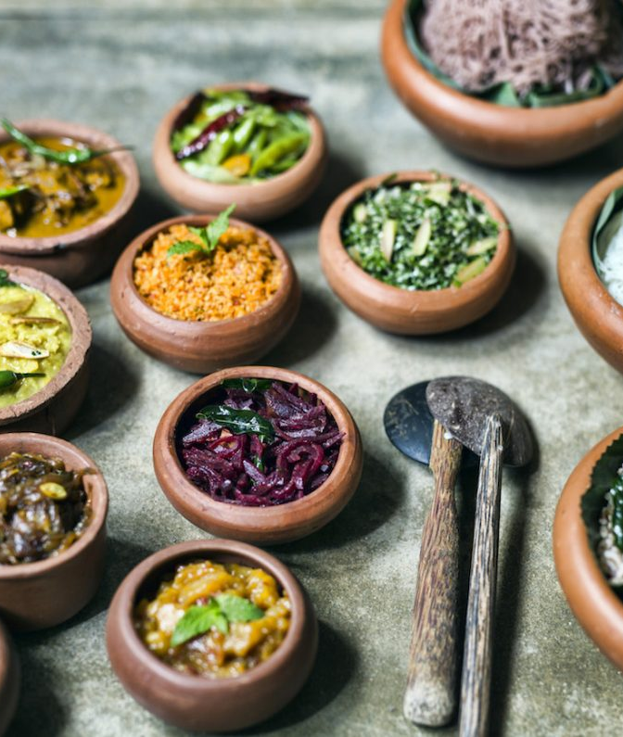
Team Members
162037 - R.P.G.S. Maleesha
162039 - W.M.S.D.K. Thalakiriyawa
162040 - T.A.R.N. Thenuwara
162044 - K.A.R.D.S.B. Wijekoon
162045 - R.A. Wijesinghe
162047 - A.M.I.U. Adhikari
162049 - G.J. Bulegodaarachchi

Slide 3
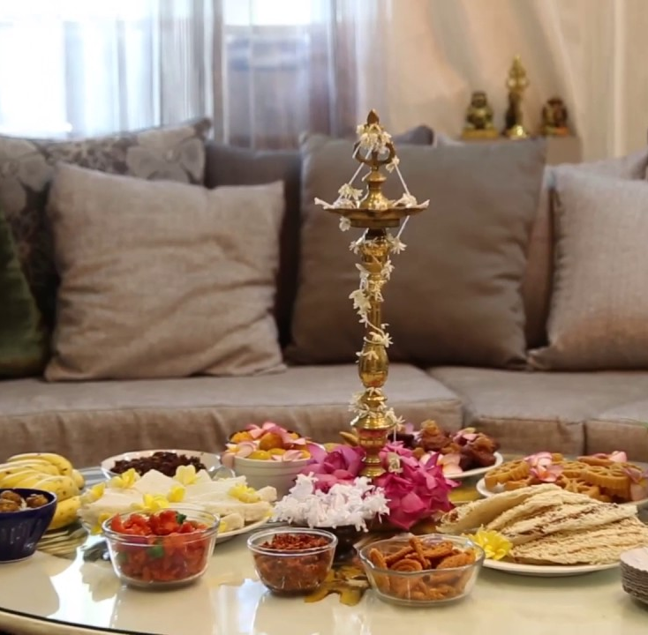
Content
Introduction
Identified Problem and Solution
Objectives
Scope of the Project
Challenges
Limitations
Tools

Slide 4

Introduction
Sri Lanka is one of the few countries with a very vast and rich cultural diversity. Different cultures come with different traditions and food.
Sri Lankan cuisine has been shaped by many historical, cultural and traditional factors.
Our website will help to identify various traditional foods in different cultures and their recipes.
We hope our website could connect people multiple cultures.

Slide 5
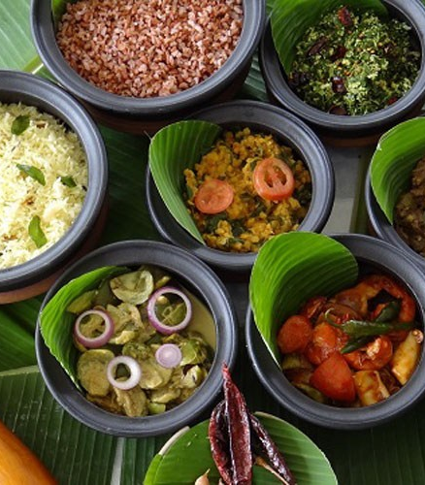
Identified Problem and Solution
Problem
People only aware of foods in their cultures. Even they want to try other food items it is difficult because of language barriers.
There was no any website which include all the recipes of various cultures and traditions.
Solution
Our website consists of multiple recipes of different cultures.
Language wouldn't be a problem for people who visit our web site.
People can get more accurate and trustworthy recipes.

Slide 6
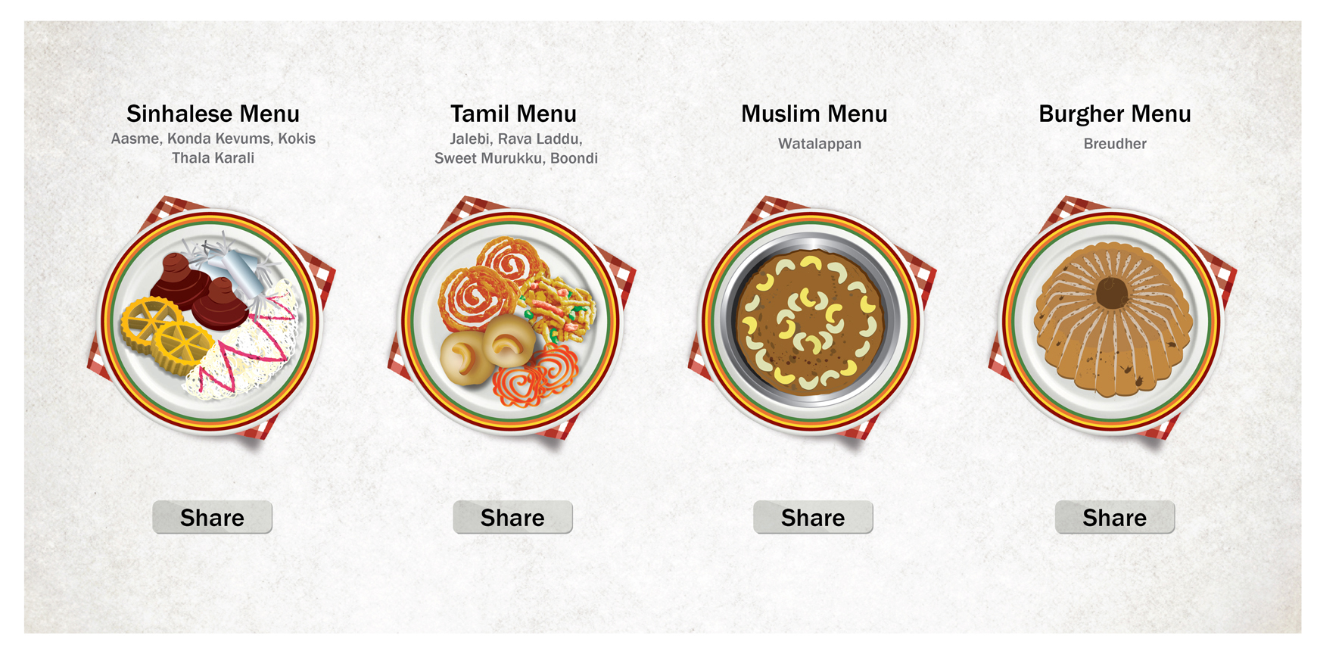
Objectives
Provide information to people about food recipes of different cultures.
1
Website is user friendly. People can select their language according to their preference.
2
3
Customers can order food items by contacting directly recipe owner or admin
4
Promote Sinhala Tamil and Muslim traditional foods in Sri Lanka for the world.

Slide 7
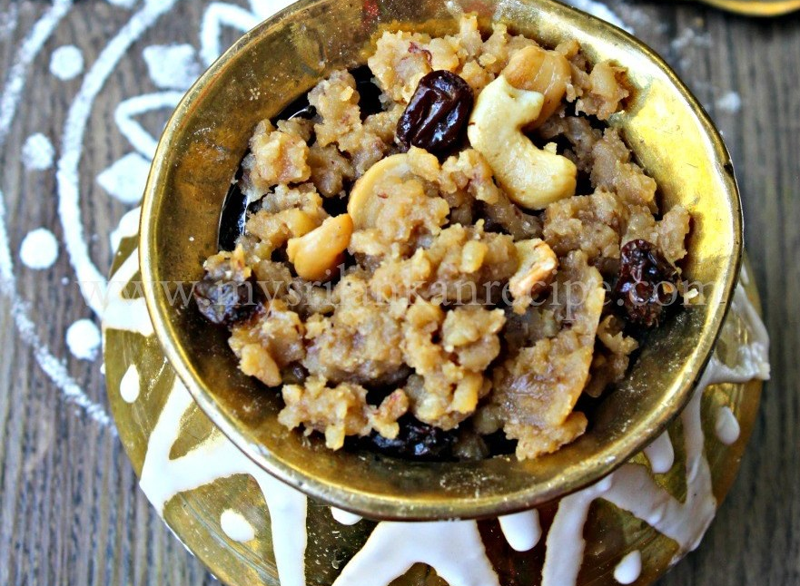
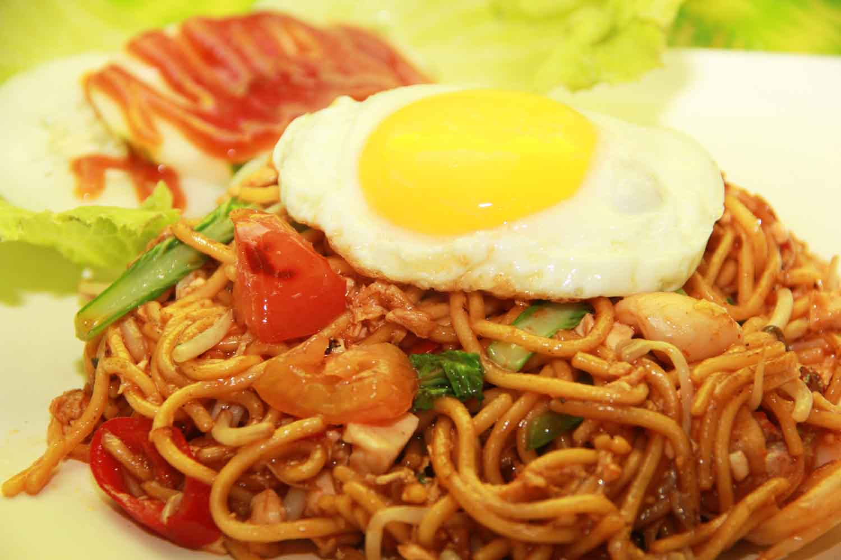
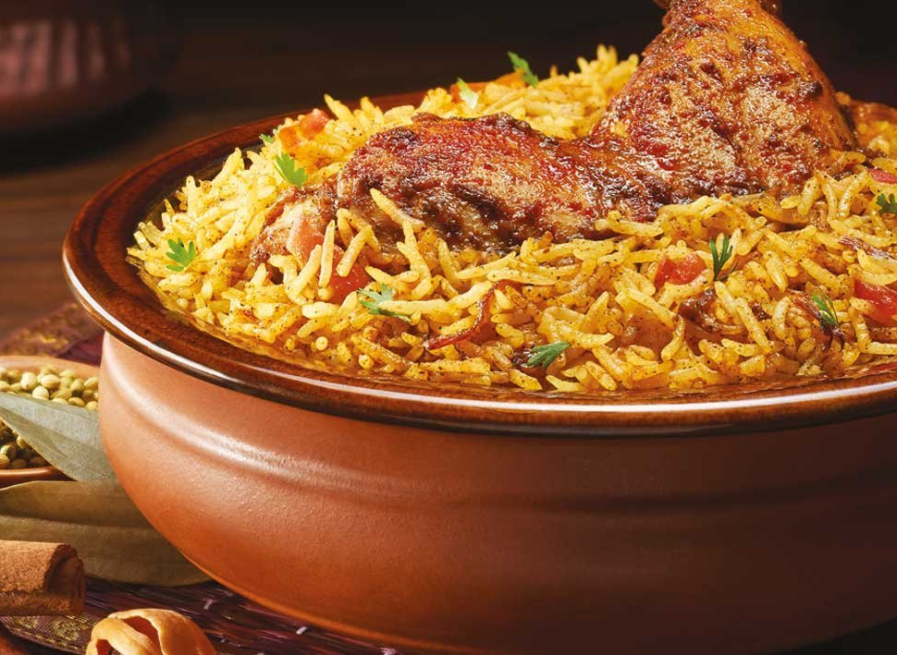
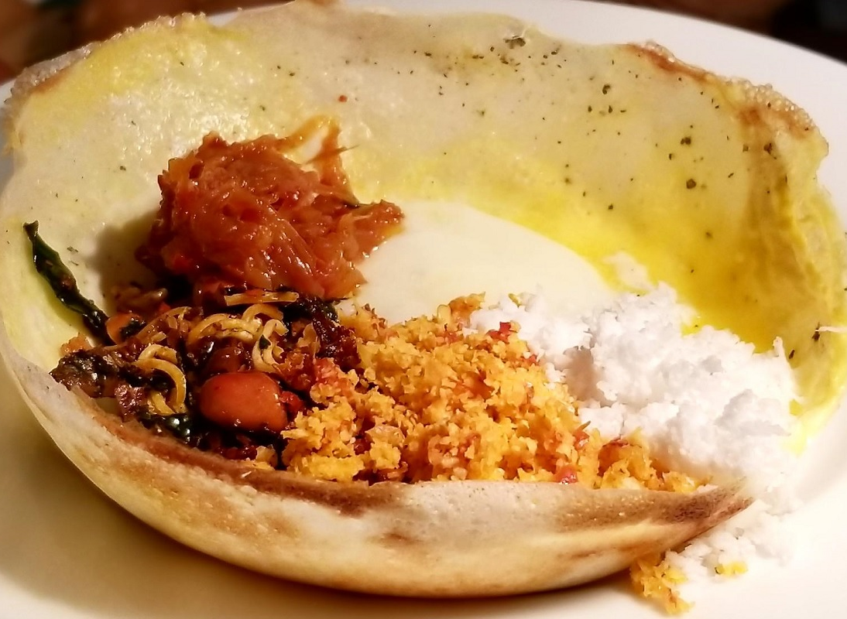
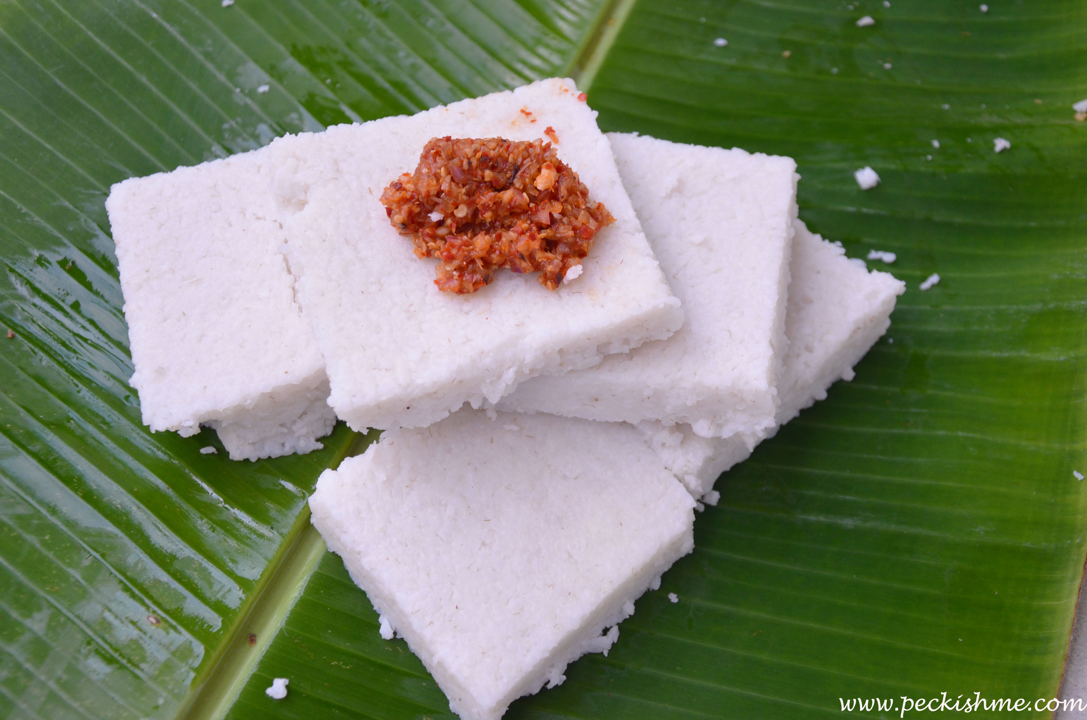
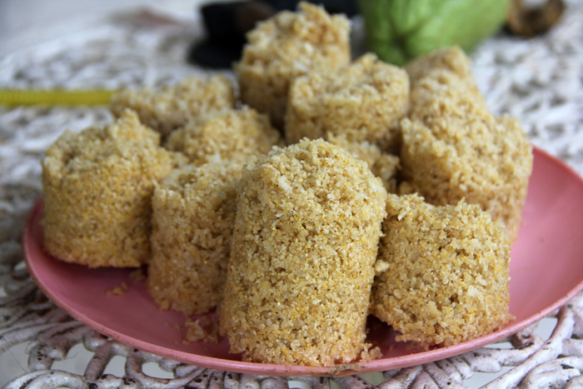
Scope of the Project
Customers can view our website and get the recipe information.
Customers are able to contact recipe owners and add comments to the web sites.
Web site provide the facilities to order food items through our site.
Admins of the website can handle the recipes and has the ownership of the site.
Admin has the authorization to publish food recipes.

Slide 8
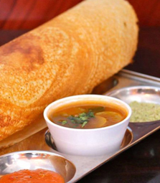
Challenges and Solutions
Difficult to find accurate food recipes. Because there are lot of recipes for the same food item.
As a solution we had to refer lot of websites and also gathered information through adults about the food recipes.
When translating information using google translate to different languages, meaningless sentences appeared.
Therefore, we had to rewrite those sentences by hand for some recipes.
And some traditional words didn’t translate through google translate.
We added new words to google translate to make our purpose easier.

Slide 9



Limitations
Admin has the authority to publish a recipes not the recipe owners
Comments will be added not for the recipe but for the food category of the website
Only admin can log and add a new admin for the website

Slide 10
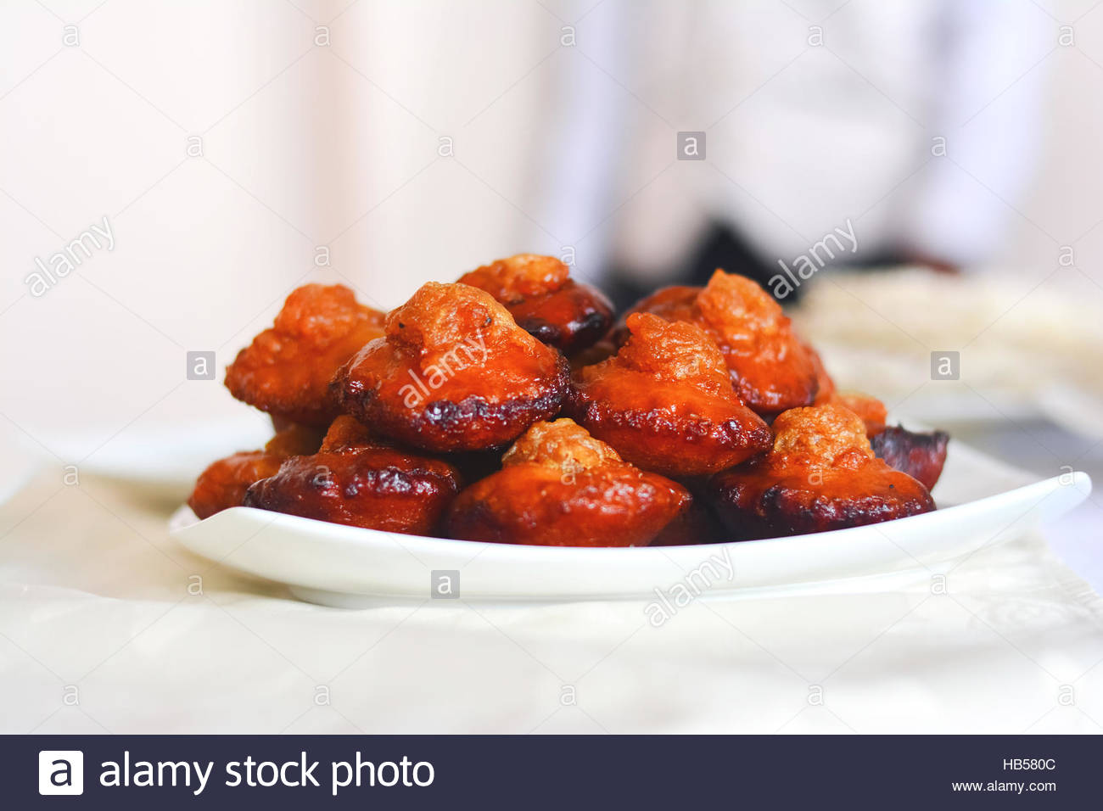


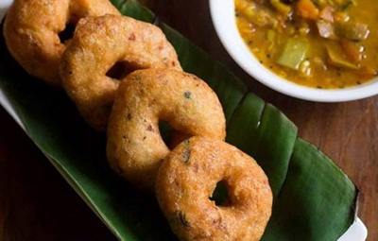



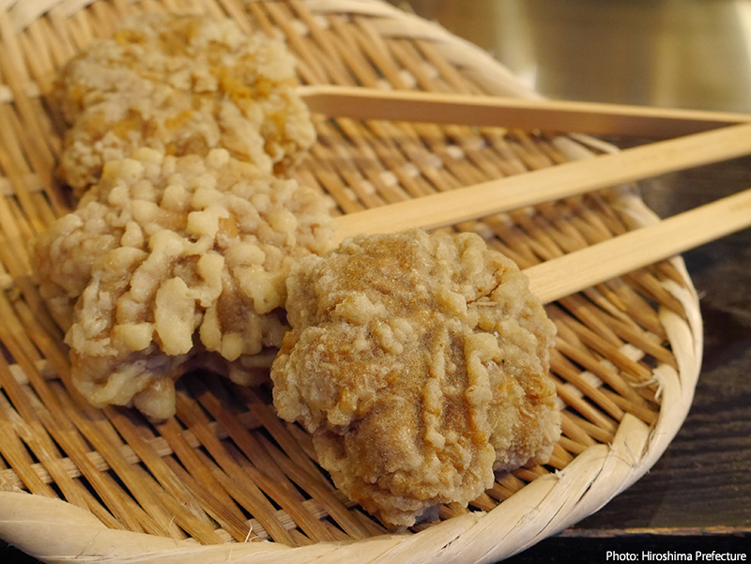

Tools & Techniques
Html
CodeIgniter
MySql
JavaScript
CSS
PHP

Slide 11
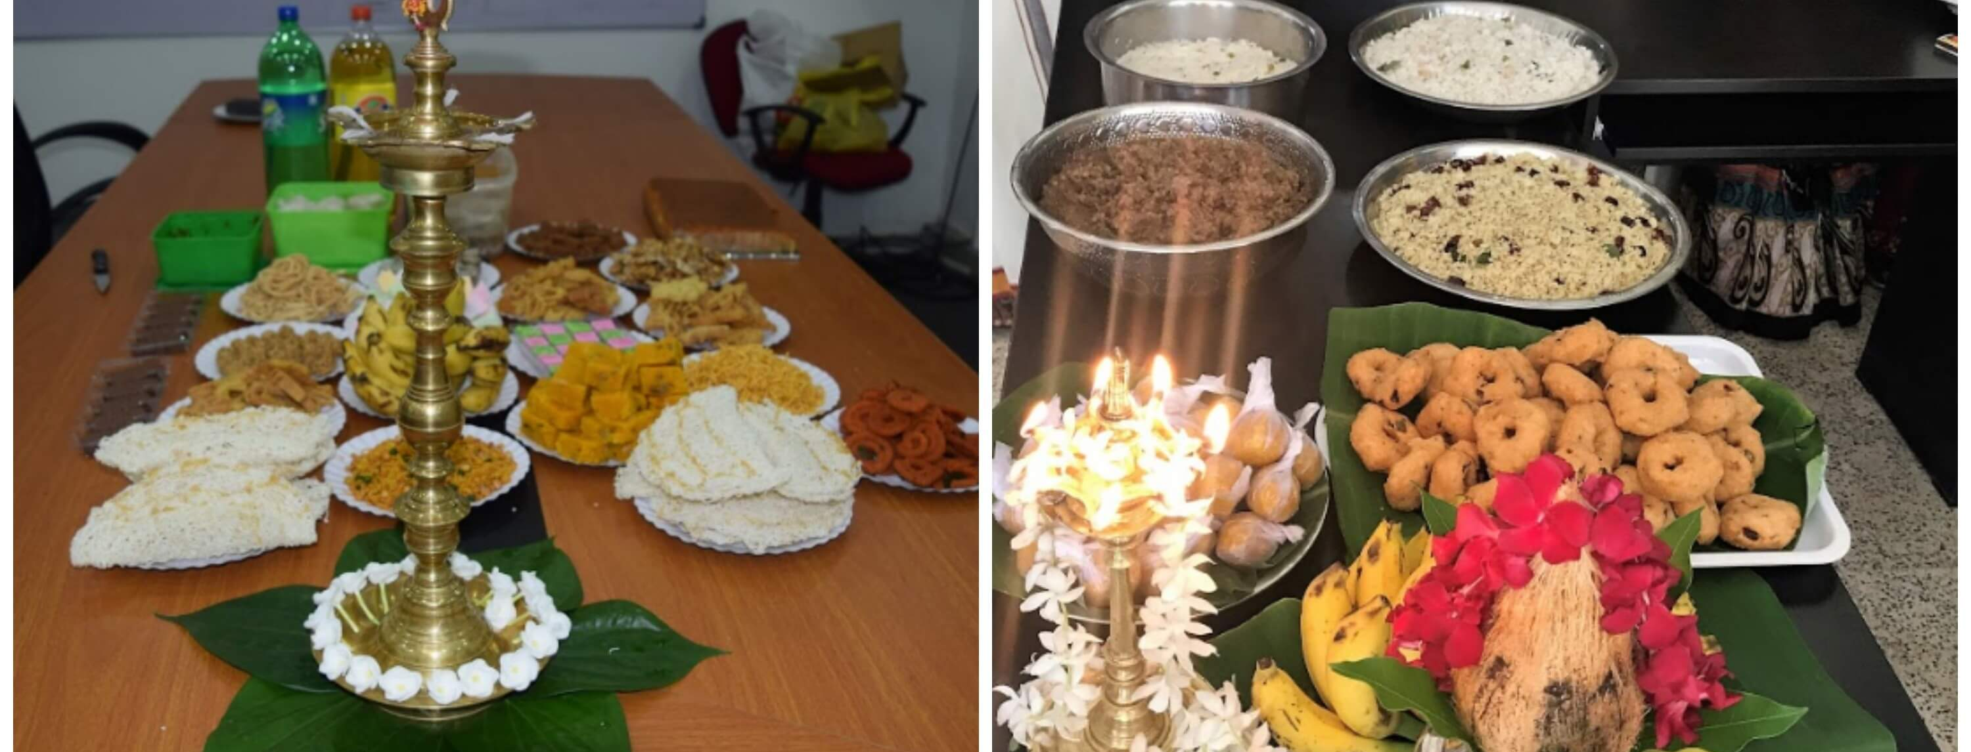
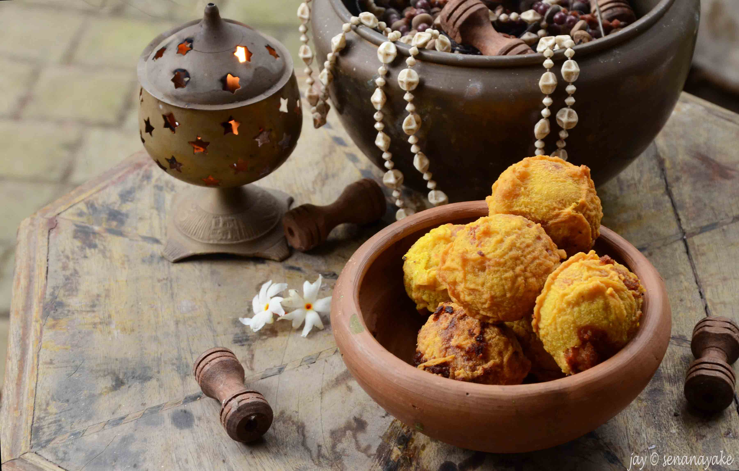
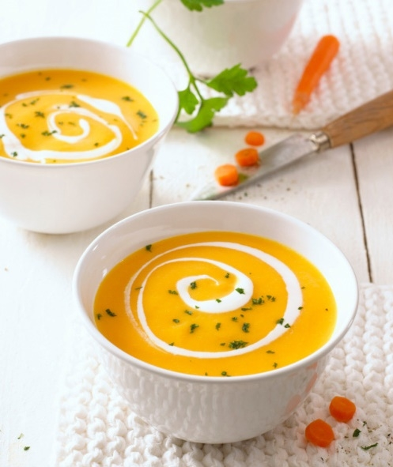
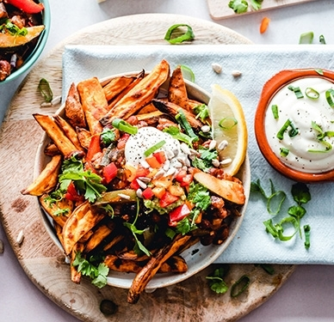
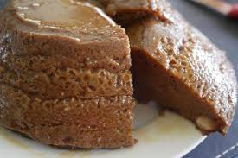
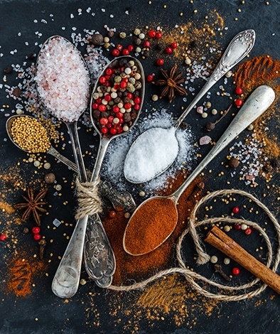
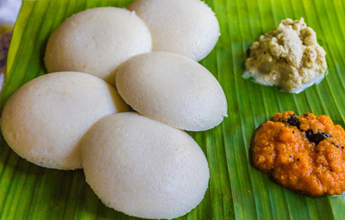
Title Here
Thank You

